Slide 1
HTML Forms
Bijan Paul
Senior Lecturer
East West University

Slide 2
Forms
Forms add the ability to web pages to not only provide the person viewing the document with dynamic information but also to obtain information from the person viewing it, and process the information.
Objectives:
Upon completing this section, you should be able to
Create a FORM.
Add elements to a FORM.
Define CGI (Common Gateway Interface).
Describe the purpose of a CGI Application.
Specify an action for the FORM.
Forms work in all browsers.
Forms are Platform Independent.

Slide 3
Forms
To insert a form we use the <FORM></FORM> tags. The rest of the form elements must be inserted in between the form tags.
<HTML> <HEAD>
<TITLE> Sample Form</TITLE>
</HEAD>
<BODY BGCOLOR="FFFFFF">
<FORM ACTION = http://www.google.com>
<P> First Name: <INPUT TYPE="TEXT" NAME="fname" MAXLENGTH="50"> </P>
<P> <INPUT TYPE="SUBMIT" NAME="fsubmit1" VALUE="Send Info"> </P>
</FORM>
</BODY> </HTML>

Slide 4
<FORM> element attributes
ACTION: is the URL of the CGI (Common Gateway Interface) program that is going to accept the data from the form, process it, and send a response back to the browser.
METHOD: GET (default) or POST specifies which HTTP method will be used to send the form’s contents to the web server. The CGI application should be written to accept the data from either method.
TARGET: is the target frame where the response page will show up.

Slide 5
Form Elements
Form elements have properties: Text boxes, Password boxes, Checkboxes, Option(Radio) buttons, Submit, Reset, File, Hidden and Image.
The properties are specified in the TYPE Attribute of the HTML element <INPUT></INPUT>.

Slide 6
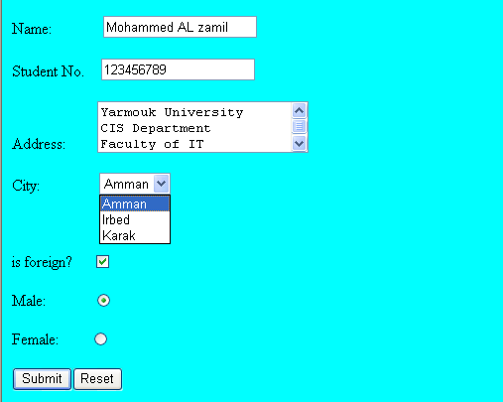
Sami Ali
Al al-Bayt University

Slide 7
Form Elements
<INPUT> Element’s Properties
TYPE= Type of INPUT entry field.
NAME = Variable name passed to CGI application
VALUE= The data associated with the variable name to be passed to the CGI application
CHECKED= Button/box checked
SIZE= Number of visible characters in text field
MAXLENGHT= Maximum number of characters accepted.

Slide 8

Text Box
Text boxes: Used to provide input fields for text, phone numbers, dates, etc.
<INPUT TYPE= " TEXT " >
Browser will display
Textboxes use the following attributes:
TYPE: text.
SIZE: determines the size of the textbox in characters. Default=20 characters.
MAXLENGHT : determines the maximum number of characters that the field will accept.
NAME: is the name of the variable to be sent to the CGI application.
VALUE: will display its contents as the default value.

Slide 9
Example on Text Box
<HTML>
<HEAD>
<TITLE>Form_Text_Type</TITLE>
</HEAD>
<BODY><h1> <font color=blue>Please enter the following Data</font></h1>
<FORM name="fome1" Method= " get " Action= " URL " >
First Name: <INPUT TYPE="TEXT" NAME="FName"
SIZE="15" MAXLENGTH="25"><BR>
Last Name: <INPUT TYPE="TEXT" NAME="LName"
SIZE="15" MAXLENGTH="25"><BR>
Nationality: <INPUT TYPE="TEXT" NAME="Country"
SIZE="25" MAXLENGTH="25"><BR>
The Phone Number: <INPUT TYPE="TEXT" NAME="Phone"
SIZE="15" MAXLENGTH="12"><BR>
</FORM> </BODY> </HTML>

Slide 10
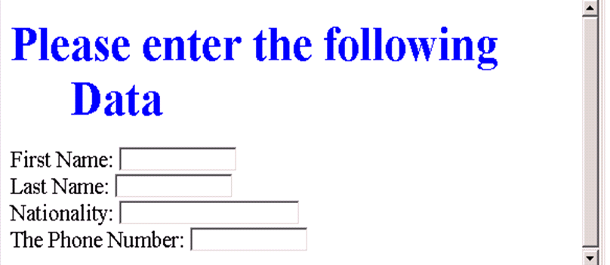
Output

Slide 11
Password
Password: Used to allow entry of passwords.
<INPUT TYPE= " PASSWORD " >
Browser will display
Text typed in a password box is starred out in the browser
display.
Password boxes use the following attributes:
TYPE: password.
SIZE: determines the size of the textbox in characters.
MAXLENGHT: determines the maximum size of the password in characters.
NAME: is the name of the variable to be sent to the CGI application.
VALUE: is usually blank.

Slide 12
Example on Password Box
<HTML><HEAD>
<TITLE>Form_Password_Type</TITLE></HEAD>
<BODY>
<h1> <font color=red>To Access, Please
enter:</font></h1>
<FORM name="fome2" Action="url" method="get">
User Name: <INPUT TYPE="TEXT" Name="FName"
SIZE="15" MAXLENGTH="25"><BR>
Password: <INPUT TYPE="PASSWORD"
NAME="PWord" value="" SIZE="15”
MAXLENGTH="25"><BR>
</FORM></BODY> </HTML>

Slide 13
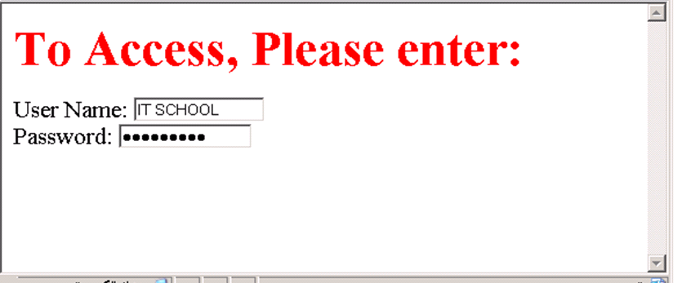
Output

Slide 14
Hidden
Hidden: Used to send data to the CGI application that you don’t want the web surfer to see, change or have to enter but is necessary for the application to process the form correctly.
<INPUT TYPE=“HIDDEN”>
Nothing is displayed in the browser.
Hidden inputs have the following attributes:
TYPE: hidden.
NAME: is the name of the variable to be sent to the CGI application.
VALUE: is usually set a value expected by the CGI application.

Slide 15
Check Box
Check Box: Check boxes allow the users to select more than one option.
<INPUT TYPE=“CHECKBOX”>
Browser will display
Checkboxes have the following attributes:
TYPE: checkbox.
CHECKED: is blank or CHECKED as the initial
status.
NAME: is the name of the variable to be sent to the
CGI application.
VALUE: is usually set to a value.

Slide 16
<HTML> <HEAD><TITLE>CheckBoxType</TITLE> </HEAD>
<BODY>
<h1> <font color=green>Please check one of the following</font></h1>
<FORM name="fome3" Action="url" method="get">
<font color=red> Select Country: </font><BR>
BANGLADESH:<INPUT TYPE="CheckBox" Name="country" CHECKED><BR>
INDIA:<INPUT TYPE="CheckBox" Name="country"><BR>
NEPAL:<INPUT TYPE="CheckBox" Name="country"><BR> <BR>
<font color=blue>Select Language:</font><BR>
BANGLA:<INPUT TYPE="CheckBox" Name="language" CHECKED><BR> English:<INPUT TYPE="CheckBox" Name="language"><BR>
French:<INPUT TYPE="CheckBox" Name="language"> <BR></FORM> </BODY></HTML>

Slide 17
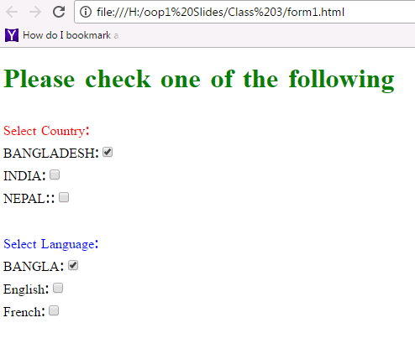
Output

Slide 18
Radio Button
Radio Button: Radio buttons allow the users to select
only one option.
<INPUT TYPE=“RADIO”>
Browser will display
Radio buttons have the following attributes:
TYPE: radio.
CHECKED: is blank or CHECKED as the initial
status. Only one radio button can be
checked
NAME: is the name of the variable to be sent to the
CGI application.
VALUE: usually has a set value.

Slide 19
<HTML> <HEAD><TITLE>CheckBoxType</TITLE> </HEAD>
<BODY>
<h1> <font color=green>Please check one of the following</font></h1>
<FORM name="fome3" Action="url" method="get">
<font color=red> Select Country: </font><BR>
BANGLADESH:<INPUT TYPE= "RADIO" Name="country" CHECKED><BR>
INDIA:<INPUT TYPE="RADIO" Name="country"><BR>
NEPAL:<INPUT TYPE="RADIO" Name="country"><BR> <BR>
<font color=blue>Select Language:</font><BR>
BANGLA:<INPUT TYPE="RADIO" Name="language" CHECKED><BR> English:<INPUT TYPE="RADIO" Name="language"><BR>
French:<INPUT TYPE="RADIO" Name="language"> <BR></FORM> </BODY></HTML>

Slide 20
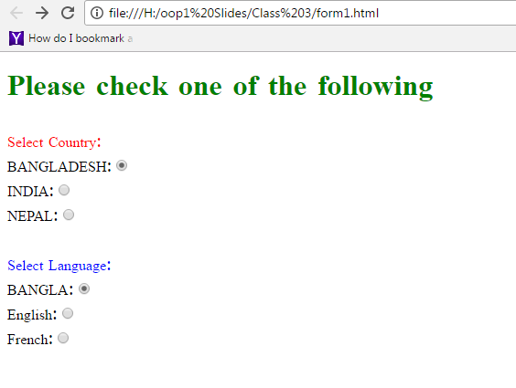

Slide 21
<HTML><HEAD>
<TITLE>RADIOBox</TITLE> </HEAD>
<BODY>
Form #1:
<FORM>
<INPUT TYPE="radio" NAME="choice" VALUE="one"> Yes.
<INPUT TYPE="radio" NAME="choice" VALUE="two"> No.
</FORM>
<HR color=red size="10" >
Form #2:
<FORM>
<INPUT TYPE="radio" NAME="choice" VALUE="three" CHECKED> Yes.
<INPUT TYPE="radio" NAME="choice" VALUE="four"> No.
</FORM>
</BODY></HTML>

Slide 22
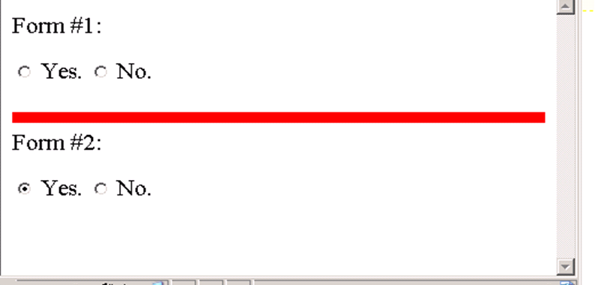
Output

Slide 23
Push Button
Push Button: This element would be used with
JavaScript to cause an action to take place.
<INPUT TYPE=“BUTTON”>
Browser will display
Push Button has the following attributes:
TYPE: button.
NAME: is the name of the button to be used
in scripting.
VALUE: determines the text label on the button.

Slide 24
<HTML><HEAD>
<TITLE>Button</TITLE> </HEAD>
<BODY>
<DIV align=center><BR><BR>
<FORM>
<FONT Color=red>
<h1>Press Here to see a baby crying:<BR>
<INPUT TYPE="button" VALUE="PressMe"><BR><BR>
<FONT Color=blue>
Click Here to see a baby shouting:<BR>
<INPUT TYPE="button" VALUE="ClickMe" > <BR><BR>
<FONT Color=green>
Hit Here to see a baby eating:<BR>
<INPUT TYPE="button" VALUE="HitME" > <BR><BR>
<FONT Color=yellow>
</FORM></DIV>
</BODY></HTML>

Slide 25
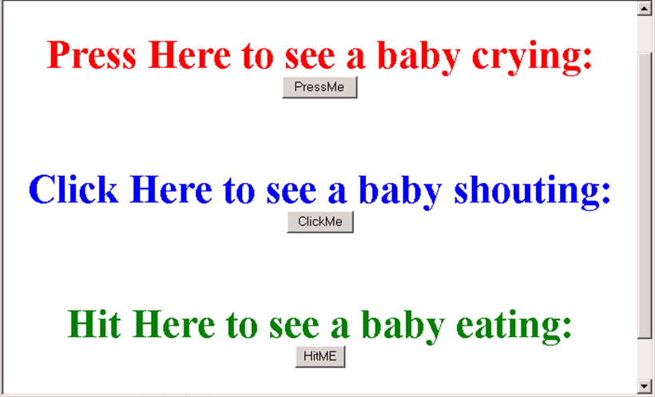

Slide 26
Submit Button
Submit: Every set of Form tags requires a Submit button. This is the element causes the browser to send the names and values of the other elements to the CGI Application specified by the ACTION attribute of the FORM element.
<INPUT TYPE=“SUBMIT”>
The browser will display
Submit has the following attributes:
TYPE: submit.
NAME: value used by the CGI script for processing.
VALUE: determines the text label on the button, usually Submit Query.

Slide 27
<HTML><HEAD>
<TITLE>Button</TITLE> </HEAD>
<BODY>
<FORM Action="URL" method="get">
First Name: <INPUT TYPE="TEXT" Size=25 name="firstName"><BR>
Family Name: <INPUT TYPE="TEXT" Size=25 name="LastName"><BR>
<BR>
<FONT Color=red>
Press Here to submit the data:<BR>
<INPUT TYPE="submit" VALUE="SubmitData " >
</FORM>
</BODY></HTML>

Slide 28
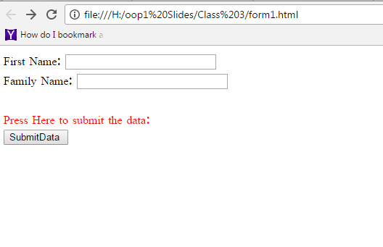

Slide 29
Reset Button
Reset: It is a good idea to include one of these for each form where users are entering data. It allows the surfer to clear all the input in the form.
<INPUT TYPE=“RESET”>
Browser will display
Reset buttons have the following attributes:
TYPE: reset.
VALUE: determines the text label on the button, usually Reset.

Slide 30
<HTML><HEAD>
<TITLE>Button</TITLE> </HEAD>
<BODY>
<FORM Action="URL" method="get">
First Name: <INPUT TYPE="TEXT" Size=25 name="firstName"> <BR>
Family Name: <INPUT TYPE="TEXT" Size=25 name="LastName"><BR>
<BR>
<FONT Color = red>
<STRONG><font size=5>Press Here to submit the data:</font></STRONG><BR>
<INPUT TYPE="submit" VALUE="SubmitData">
<INPUT TYPE="RESET" VALUE="Reset">
</FORM>
</BODY></HTML>

Slide 31
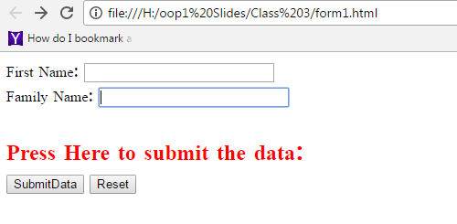

Slide 32
Image Submit Button
Image Submit Button: Allows you to substitute an image for the standard submit button.
<INPUT TYPE=“IMAGE” SRC=“BD.gif”>
Image submit button has the following attributes:
TYPE: Image.
NAME: is the name of the button to be used in scripting.
SRC: URL of the Image file.

Slide 33
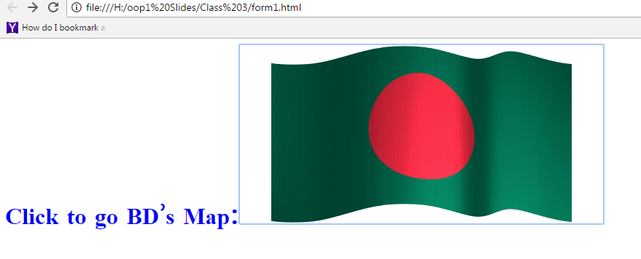
<form> <H1><font color=blue> Click to go BD’s Map: <INPUT TYPE="IMAGE" SRC="BD.gif"> </form>

Slide 34

File
File Upload: You can use a file upload to allow surfers to upload files to your web server.
<INPUT TYPE=“FILE”>
Browser will display
File Upload has the following attributes:
TYPE: file.
SIZE: is the size of the text box in characters.
NAME: is the name of the variable to be sent to the
CGI application.
MAXLENGHT: is the maximum size of the input in the
textbox in characters.

Slide 35
<BODY bgcolor=lightblue>
<form>
<H3><font color=forestgreen>
Please attach your file here to for uploading to
My <font color =red>SERVER...<BR>
<INPUT TYPE="File" name="myFile" size="30">
<INPUT TYPE="Submit" value="SubmitFile">
</form>
</BODY>

Slide 36
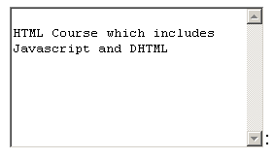
Other Elements used in Forms
<TEXTAREA></TEXTAREA>: is an element that allows for free form text entry.
Browser will display
Textarea has the following attributes:
NAME: is the name of the variable to be sent to the CGI application.
ROWS: the number of rows to the textbox.
COLS: the number of columns to the textbox.

Slide 37
<BODY bgcolor=lightblue>
<form>
<TEXTAREA COLS=40 ROWS=20 Name="comments" >
From observing the apathy of those
about me during flag raising I
concluded that patriotism if not
actually on the decline is at least
in a state of dormancy.
Written by Khaled Al-Fagih
</TEXTAREA>:
</form>
</BODY>

Slide 38
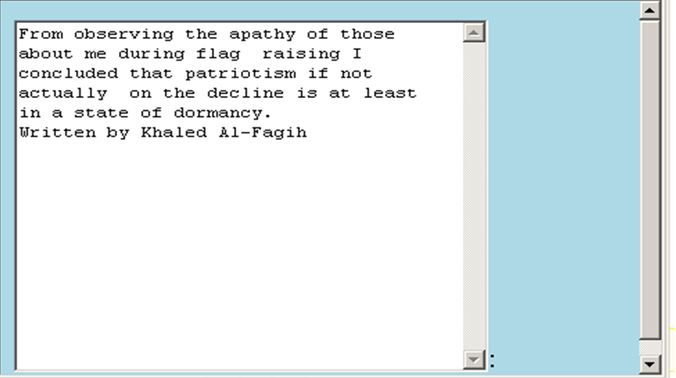

Slide 39
Other Elements used in Forms
The two following examples are <SELECT></SELECT> elements, where the attributes are set differently.
The Select elements attributes are:
NAME: is the name of the variable to be sent to the CGI application.
SIZE: this sets the number of visible choices.
MULTIPLE: the presence of this attribute signifies that the user can make multiple selections. By default only one selection is allowed.

Slide 40
<BODY bgcolor=lightblue>
<form>
Select the cities you have visited:
<SELECT name=“list” size=5>
<option> London</option>
<option> Tokyo</option>
<option> Paris</option>
<option> New York</option>
<option> LA</option>
<option> KL</option>
</SELECT>
</form>
</BODY>

Slide 41
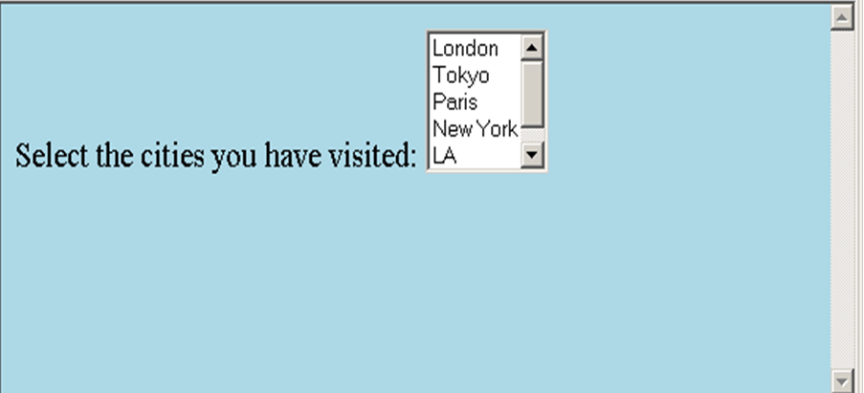

Slide 42
Other Elements used in Forms
Drop Down List:
Name: is the name of the variable to be sent to the CGI application.
Size: 1.

Slide 43

Other Elements used in Forms
List Box:
Name: is the name of the variable to be sent to the CGI application.
SIZE: is greater than one.

Slide 44
Other Elements used in Forms
Option
The list items are added to the <SELECT> element by inserting <OPTION></OPTION> elements.
The Option Element’s attributes are:
SELECTED: When this attribute is present, the option is selected when the document is initially loaded. It is an error for more than one option to be selected.
VALUE: Specifies the value the variable named in the select element.

Slide 45
</HEAD>
<BODY>
<h2><font color=blue>What type of Computer do you have?</font><h2>
<FORM>
<SELECT NAME="ComputerType" size=4>
<OPTION value="IBM" SELECTED> IBM</OPTION>
<OPTION value="INTEL"> INTEL</OPTION>
<OPTION value=" Apple"> Apple</OPTION>
<OPTION value="Compaq"> Compaq</OPTION>
</SELECT>
</FORM></BODY></HTML>

Slide 46
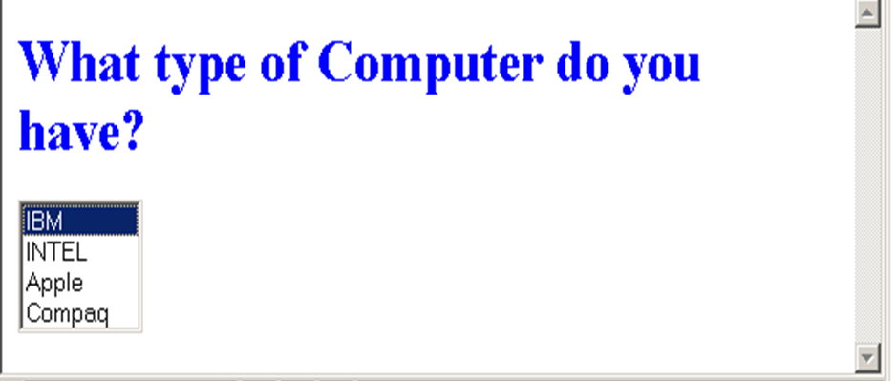

Slide 47
<HEAD> <TITLE>SELECT with Mutiple </TITLE> </HEAD>
<BODY>
<h2><font color=blue>What type of Computer do you have?</font><h2>
<FORM>
<SELECT NAME="ComputerType" size=5 multiple>
<OPTION value="IBM" > IBM</OPTION>
<OPTION value="INTEL"> INTEL</OPTION>
<OPTION value=" Apple"> Apple</OPTION>
<OPTION value="Compaq" SELECTED> Compaq</OPTION>
<OPTION value=" other"> Other</OPTION>
</SELECT>
</FORM></BODY></HTML>

Slide 48
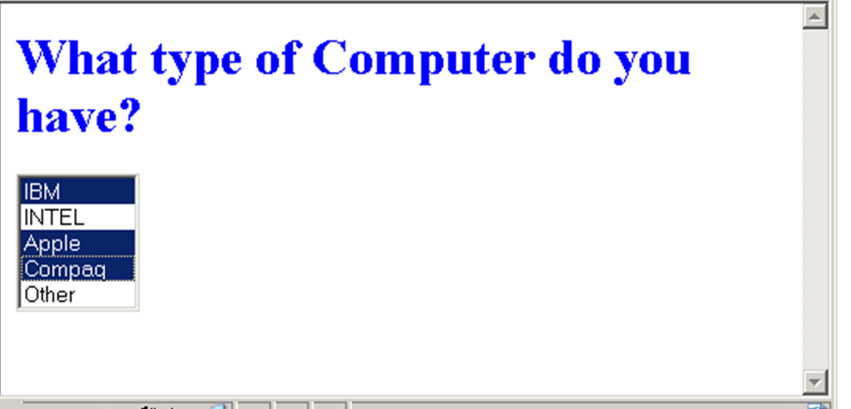

Slide 49
